Slide 1

Deck for Dallas Pets Alive!

Slide 2
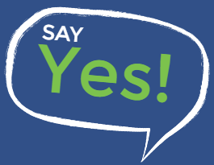
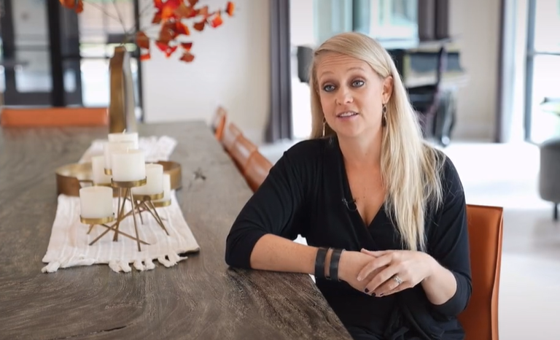
Say YES!
“We can change animal welfare here in North Texas if we all step up and say yes I want to help.”
- Leslie
Concept: Say Yes Campaign
Say Yes to:
Fostering,
Donating,
Adoption,
Volunteering…

Slide 3
Say Yes!
Execution
  Social Media content per each platform – Twitter, Facebook, Instagram, TikTok, YouTube.
  “Say Yes!” events with partners and sponsors.
  Corresponding “Say Yes!” swag.
  “Say Yes!” ongoing brand campaign with adoptables and brand mission statements.

Slide 4
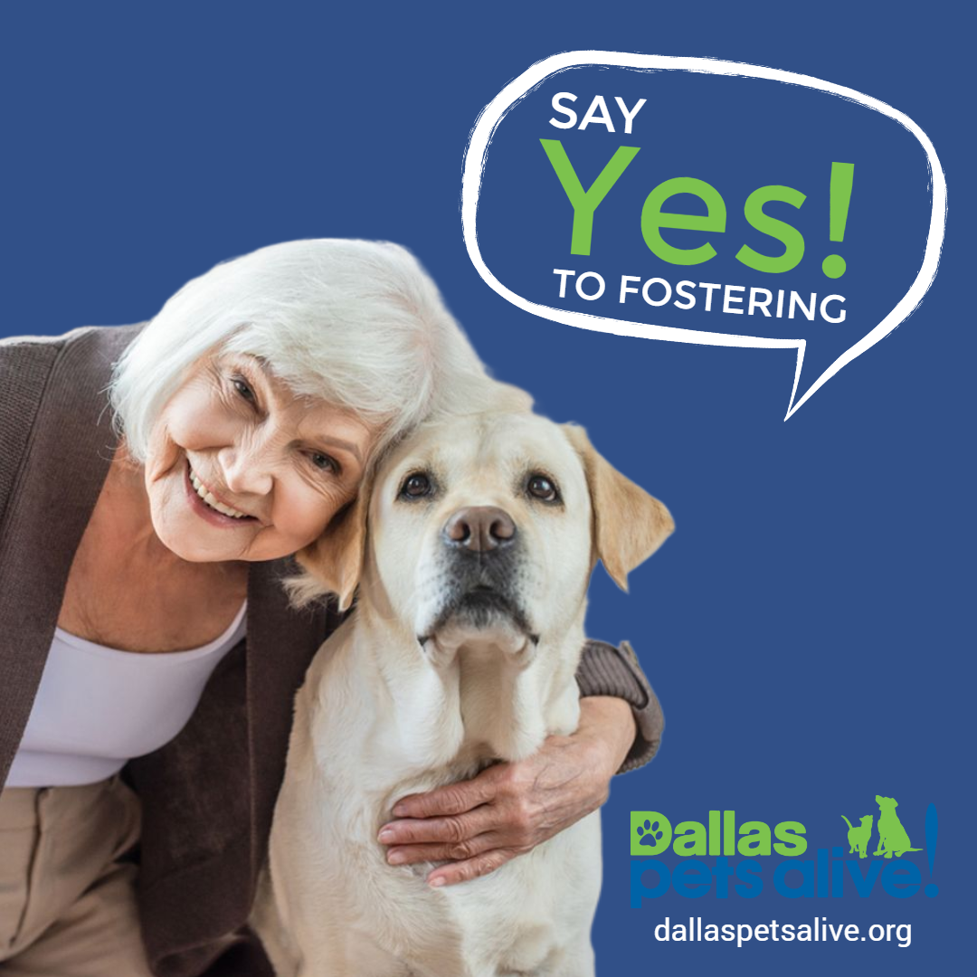
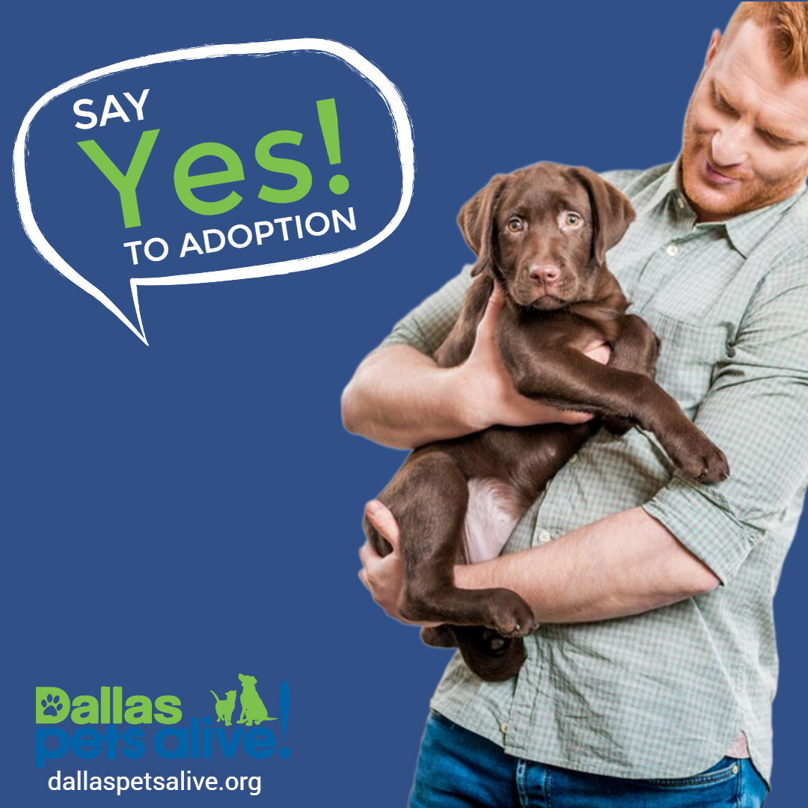
examples

Slide 5

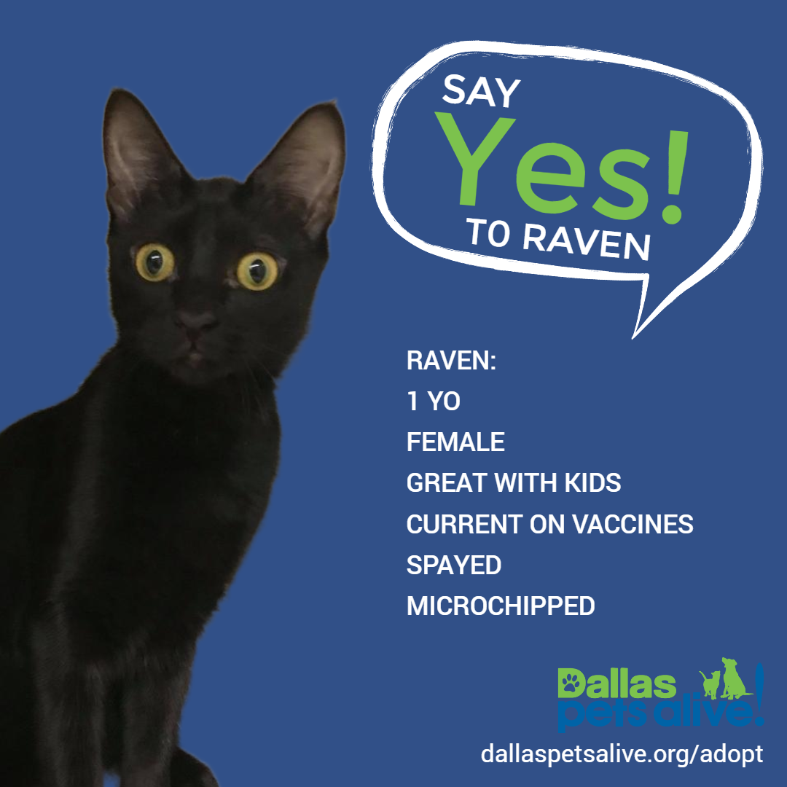
Examples

Slide 6


Examples

